Slide 1



DATAVERSE HACKATHON (AI&ML)
By Team-> Executioners

Slide 2
CONTENTS
DATA CLEANING | The process of identifying and correcting errors or inconsistencies in data and improve it’s quality.
DATA FILTERING | The act of selecting specific data subsets based on defined criteria to focus on relevant information
DATA PROCESSING | The transformation of raw data into a more usable format through various operations and manipulations
DATA COMPUTING | The application of algorithms and calculations to analyze data and derive insights.
DATA ANALYSIS | The systematic examination of data to extract meaningful patterns, trends, and conclusions.
DATA VISUALIASTION | The graphical representation of data to communicate insights clearly and effectively through visual formats.

Slide 3


INITIAL CONDITIONS
We are provided with a csv file containing information of CO2 emissions by different countries throughout some yarly interval along with the the industries targetting the emissions.

Slide 4
THINGS DONE THROUGHOUT
CLEANING
FILTERING
VISUALISATION
Cleaning the rows with the null values and according to initial conditions
Filtering the values with the unoriented data and misuseful informations
Ploting the cleaned dataset via the use of various ploting libraries

Slide 5

DATA CLEANING & FILTERING
BRIEF EXPLANATION OF EACH COMMAND IS GIVEN IN THE JUPYTER NOTEBOOK

Slide 6
Basic imports and read commands
import pandas as pd
import numpy as np
import seaborn as sns
import matplotlib.pyplot as plt
%matplotlib inline
df = pd.read_csv('data.csv')

Slide 7
Cleaning the Data According to the Initial conditions
df_cleaned = df.drop(columns=["Indicator"])
df_cleaned = df_cleaned[df_cleaned["CTS_Name"] != 'CO2 Emissions Multipliers']
df_cleaned = df_cleaned[df_cleaned["CTS_Name"] != 'CO2 Emissions Intensities']
df_cleaned.isnull()
sns.heatmap(df_cleaned.isnull(),yticklabels = False,cbar =False,cmap = 'viridis')

Slide 8
REMOVING THE NULL VALUES AND FILLING ZEROS
df_cleaned.drop('F2003',axis=1,inplace = True)
sns.heatmap(df_cleaned.isnull(),yticklabels = False,cbar =False,cmap = 'viridis')
columns_to_fill = ['F1995', 'F1996', 'F1997', 'F1998', 'F1999', 'F2000',
'F2001', 'F2002', 'F2004', 'F2005', 'F2006', 'F2007',
'F2008', 'F2009', 'F2010', 'F2011', 'F2012', 'F2013',
'F2014', 'F2015', 'F2016', 'F2017', 'F2018']
df_cleaned[columns_to_fill] = df_cleaned[columns_to_fill].fillna(0)
df_cleaned = df_cleaned.dropna(subset=['Scale’])
sns.heatmap(df_cleaned.isnull(),yticklabels = False,cbar =False,cmap = 'viridis’)
df_cleaned.to_csv('cleaned2.csv', index=False)

Slide 9
VISUALISATION
PLOTTING AND ANALYSIS OF THE CLEANED AND FILTERED DATA

Slide 10
plt.figure(figsize=(14, 8)) bar_plot = sns.barplot(x='Country', y='Total_F2012', data=summed_values_df) plt.title('Total F2012 Values by Country') plt.xlabel('Country') plt.ylabel('Total F2012 Value') plt.xticks(rotation=45, ha='right') plt.grid() def format_y_values(value, tick_number): return f'{int(value):,}' plt.gca().yaxis.set_major_formatter(FuncFormatter(format_y_values)) for p in bar_plot.patches: bar_plot.annotate(f'{int(p.get_height()):,}', (p.get_x() + p.get_width() / 2., p.get_height()), ha='center', va='bottom', fontsize=10, color='black', xytext=(0, 5), textcoords='offset points') plt.tight_layout() plt.show()
import seaborn as sns
import matplotlib.pyplot as plt
import pandas as pd
from matplotlib.ticker import FuncFormatter
unique_countries = df_cleaned['Country'].unique()
summed_values = []
for country in unique_countries:
filtered_df = df_cleaned[df_cleaned['Country'] == country]
year2012 = filtered_df['F2012'].sum()
summed_values.append({'Country': country, 'Total_F2012': year2012})
summed_values_df = pd.DataFrame(summed_values)
summed_values_df = summed_values_df.sort_values(by='Total_F2012', ascending=False)
print(summed_values_df)

Slide 11
CODE PREVIOUSLY WAS THE PLOTTING OF THE EMISSIONS DONE BY VARIOUS COUNTRIES IN YEAR 2012

Slide 12
data=top_10_industries_df) plt.title('Top 10 Industries by Total Values of F1995 to F2018') plt.xlabel('Industry') plt.ylabel('Total Sum') plt.xticks(rotation=45, ha='right') plt.grid() def format_y_values(value, tick_number): return f'{int(value):,}' # Format as integers with commas plt.gca().yaxis.set_major_formatter(FuncFormatter(format_y_values)) for p in bar_plot.patches: bar_plot.annotate(f'{int(p.get_height()):,}', (p.get_x() + p.get_width() / 2., p.get_height()), ha='center', va='bottom', fontsize=10, color='black', xytext=(0, 5), textcoords='offset points') plt.tight_layout() plt.show()
import seaborn as sns
import matplotlib.pyplot as plt
import pandas as pd
from matplotlib.ticker import FuncFormatter
columns_to_sum = ['F1995', 'F1996', 'F1997', 'F1998', 'F1999', 'F2000',
'F2001', 'F2002', 'F2004', 'F2005', 'F2006', 'F2007',
'F2008', 'F2009', 'F2010', 'F2011', 'F2012', 'F2013',
'F2014', 'F2015', 'F2016', 'F2017', 'F2018']
unique_industries = df_cleaned['Industry'].unique()
summed_values = []
for industry in unique_industries:
filtered_df = df_cleaned[df_cleaned['Industry'] == industry]
total_values = filtered_df[columns_to_sum].sum()
summed_values.append({'Industry': industry, **total_values})
summed_values_df = pd.DataFrame(summed_values)
summed_values_df['Total_Sum'] = summed_values_df[columns_to_sum].sum(axis=1)
summed_values_df = summed_values_df.sort_values(by='Total_Sum', ascending=False)
top_10_industries_df = summed_values_df.head(10)
print(top_10_industries_df)
plt.figure(figsize=(14, 8)) # Increase figure size for better spacing
bar_plot = sns.barplot(x='Industry', y='Total_Sum',

Slide 13
CODE PREVIOUSLY WAS THE PLOTTING THE CO2 EMMISIONS DONE BY VARIOUS INDUSTRIES OF DIFFERENT COUNTIRES BETWEEN 1995-2018

Slide 14
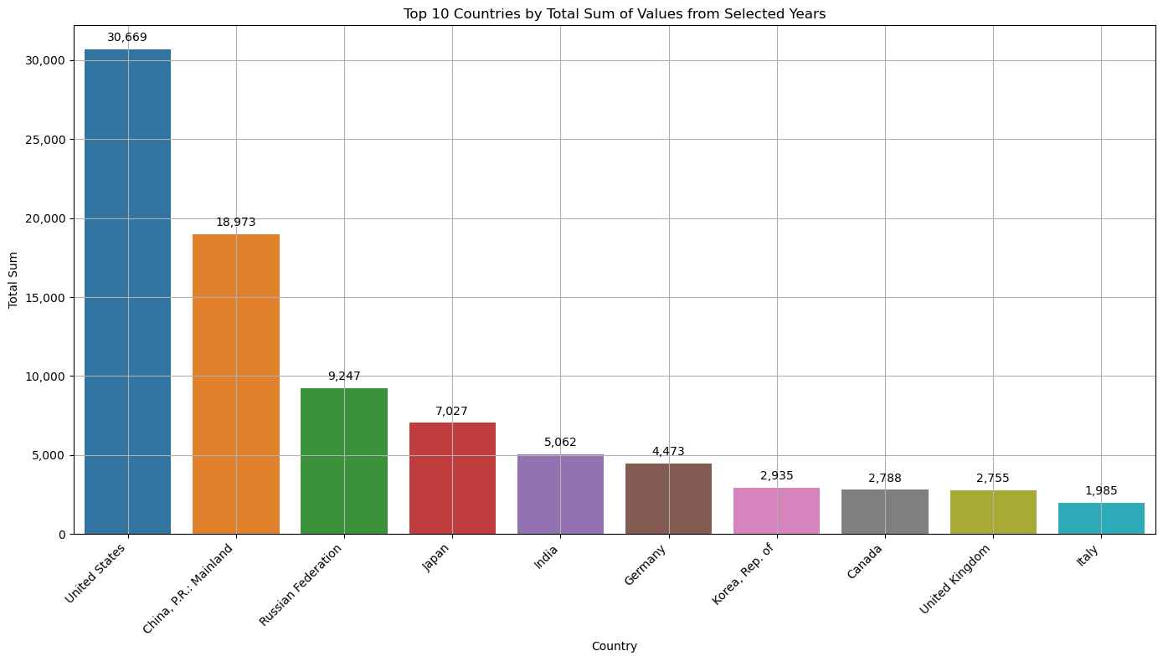
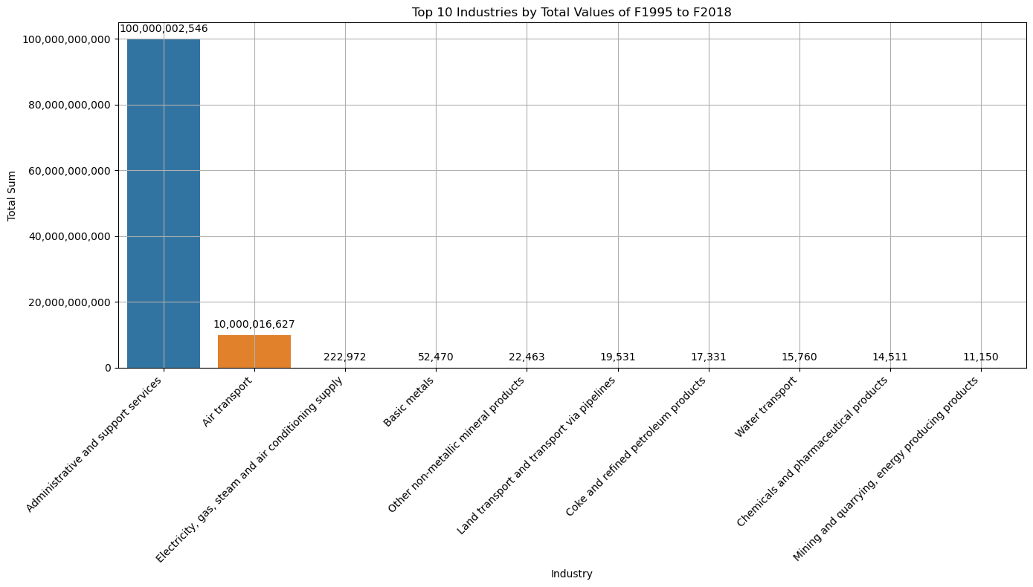
PREDICTED RESULTS
The Top-10 Countries with CO2 Emission
The Top-10 Industries with CO2 Emission

Slide 15

THANKS!
~Team Executioners
Manas Tripathi
Anurag Singh
Tanmay Mishra

